Slide 1

Excel Final Exam
- LVADSUSR189_4397

Slide 2
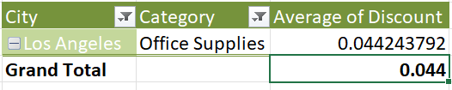
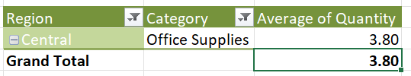
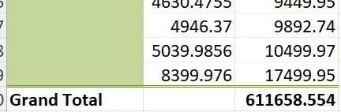

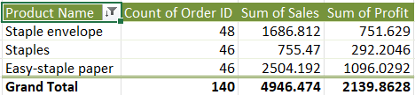
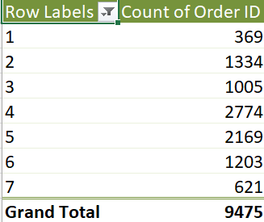

MCQ

Slide 3

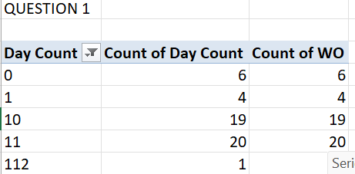
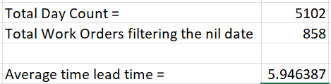

TASK 1
Used Dateif function to find the difference between Reqdate and WokDate.
Now created pivot table with the day count and count of work orders. Day count also has num values because of missing work days. Filtered that and got count
Now found the total day count and total work orders after filtering and then fount average

Slide 4
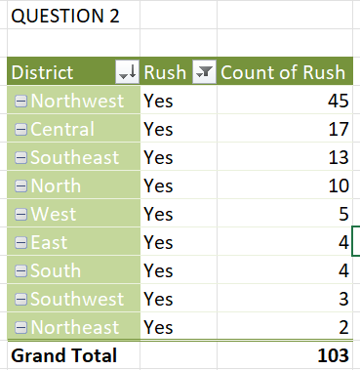
TASK 2
Created pivot chart’
The district NORTHWEST has the highest rush hour count of 45

Slide 5
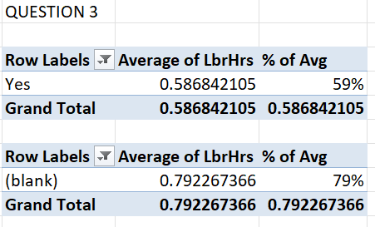
TASK 3
If Rush Hour – the average labour hour is 0.58 or 59%
During non rush hour, the average labour hour is 0.79 or 79%

Slide 6
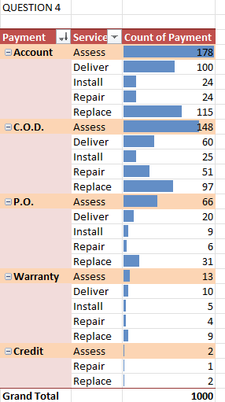
TASK 4
The pivot table shows the distribution of payment method for each services
We can infer that Assess service has the highest count of each payment methods.
Replaces becomes the service with lowest count of each payment services
Account payment is used more. Credit used less

Slide 7
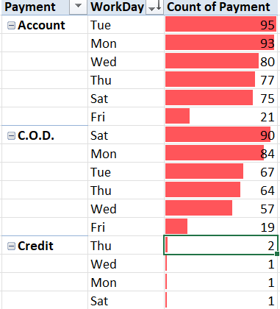
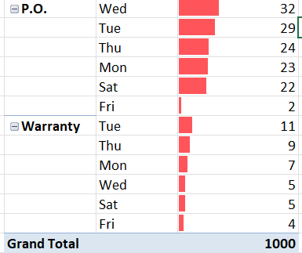
TASK 5
Account is the highest mode of payment method used
We could infer that every day in the week, account payment is used more.
Credit payment less

Slide 8
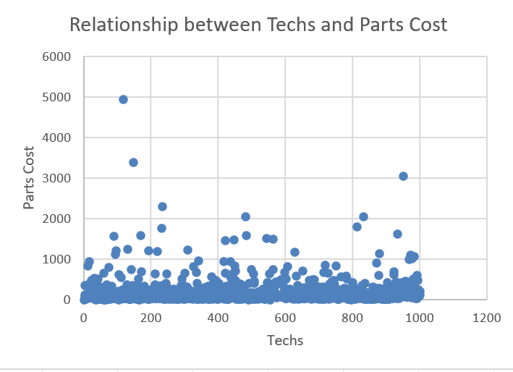
TASK 6
Created a scatter plot chart between Techs and Parts Cost to show relationship
It is inferred that it has a mild positive relationship between each variable

Slide 9
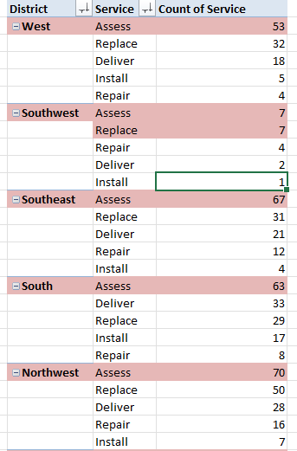
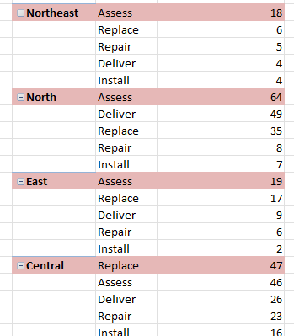
TASK 7
The pivot table shows the most common service for each district with the count of services highlighted
Assess is highest service in all districts
Install is lowest service all districts expect WEST where repair is the lowest

Slide 10
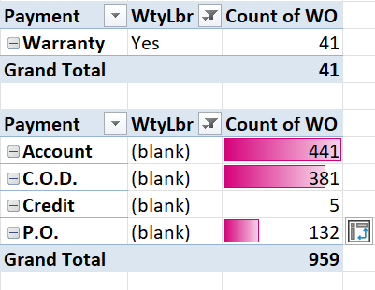
TASK 8
The tables show the difference between payment methods depending on the wtylbr
If wtylbr is yes, then only warranty payment is applicable according to the data
Likewise we can infer that if the wtylbr is NO , then the payment distribution is shown which excludes warranty as it only applies if wty lbr is yes

Slide 11
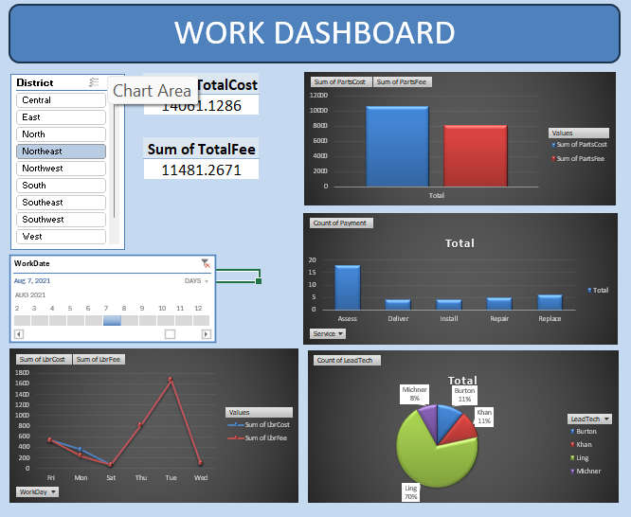
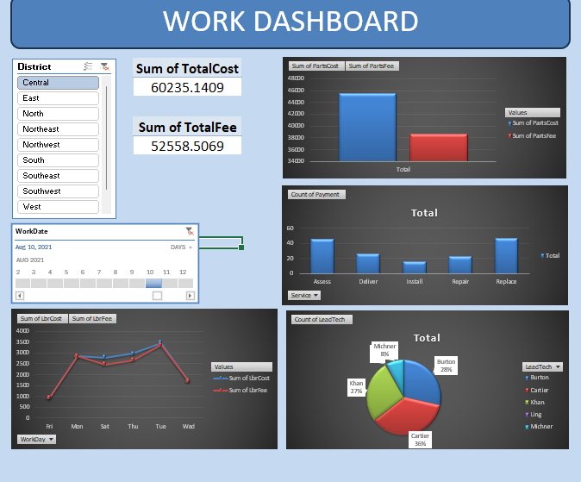
DASHBOARD

